Slide 1

307102 Descriptive Statistics for Business
Introduction to Estimation in Statistics
2024-2

Slide 2
Content
Introduction to Inferential Statistics
Estimation in Statistics (Point Estimate and Interval Estimate)
The Central Limit Theorem (CLT)
Confidence Intervals – Using Z-Tables
Confidence Intervals – Using T-Tables

Slide 3
Estimation in Statistics
Often in statistics we’re interested in measuring population parameters.
Two of the most common population parameters are:
Population mean: the mean value of some variable in a population (e.g. the mean height of males in the U.S.)
Population proportion: the proportion of some variable in a population (e.g. the proportion of residents in a county who support a certain law)
Although we’re interested in measuring these parameters, it’s usually too costly and time-consuming to go around and collect data on every individual in a population in order to calculate the population parameter.
Instead, we typically take a random sample from the overall population and use data from the sample to estimate the population parameter.

Slide 4
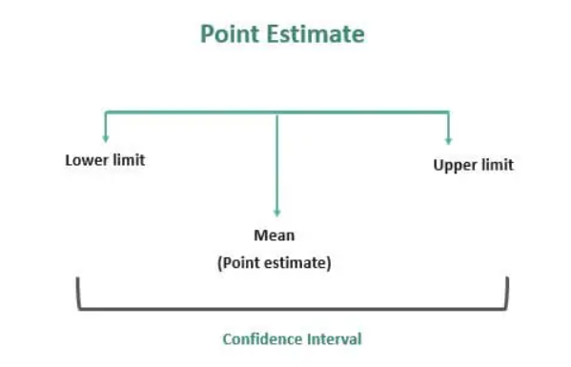
Point vs. Interval
A point estimate is a single value estimate of a parameter. For instance, a sample mean is a point estimate of a population mean.
An interval estimate gives you a range of values where the parameter is expected to lie.
Both types of estimates are important for gathering a clear idea of where a parameter is likely to lie.

Slide 5
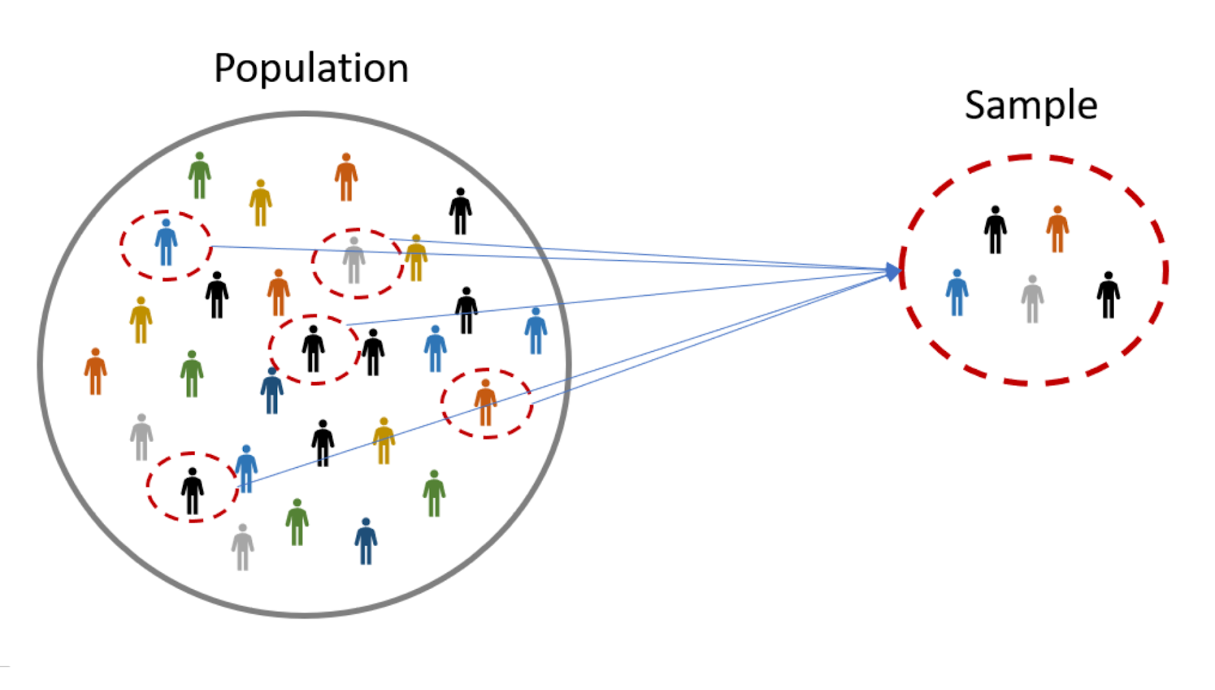
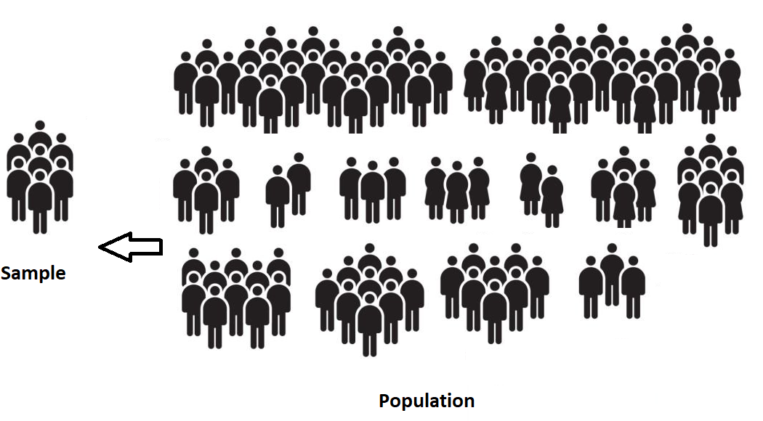
Point Estimates
Suppose we want to estimate the mean weight of a students in the university.
Since there are thousands of students in the university, it would be extremely time-consuming and costly to go around and weigh each individual student.
Instead, we might take a random sample of 50 students and use the mean weight of the students in this sample to estimate the true population mean.
In this case, the mean weight of the sample is called a Point Estimate for the true mean weight of the population.

Slide 6
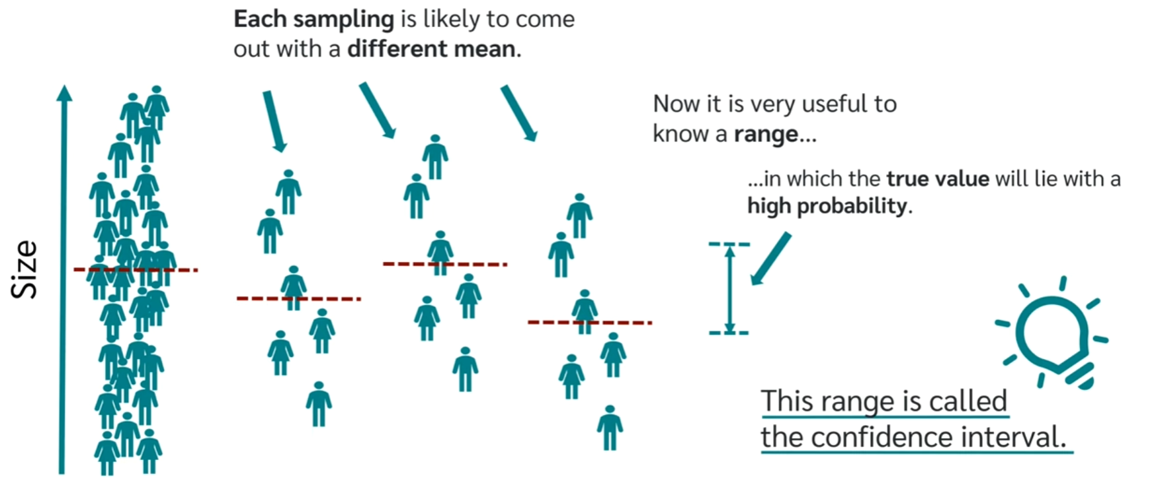
Interval Estimates - Confidence Intervals
The problem with the previous example is that the mean weight of students in the sample is not guaranteed to exactly match the mean weight of students in the whole population.
For example, we might just happen to pick a sample full of low-weight students or perhaps a sample full of heavy students.
To capture this uncertainty, we can create an Interval Estimate or a confidence interval around our point estimate.
The confidence interval gives us a range of values that are likely to contain the true population parameter.

Slide 7
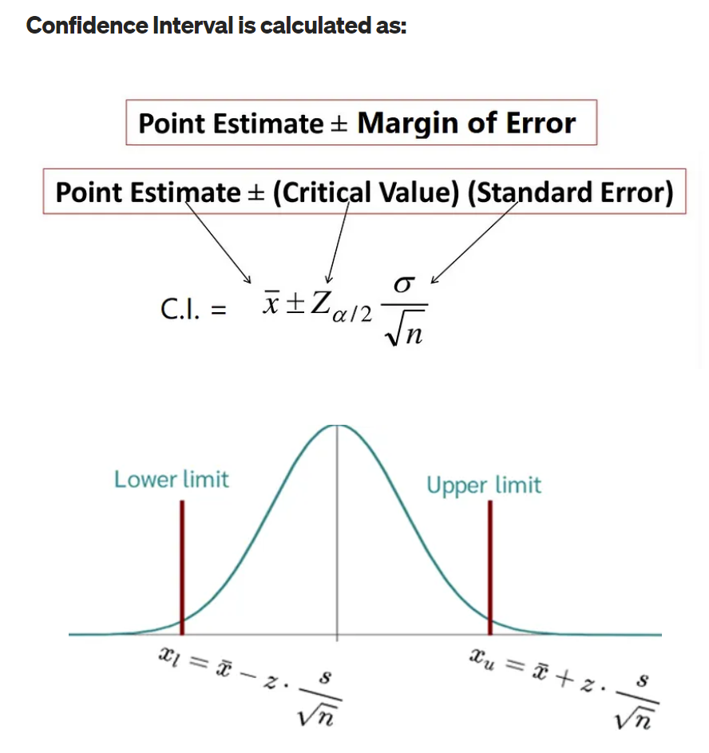
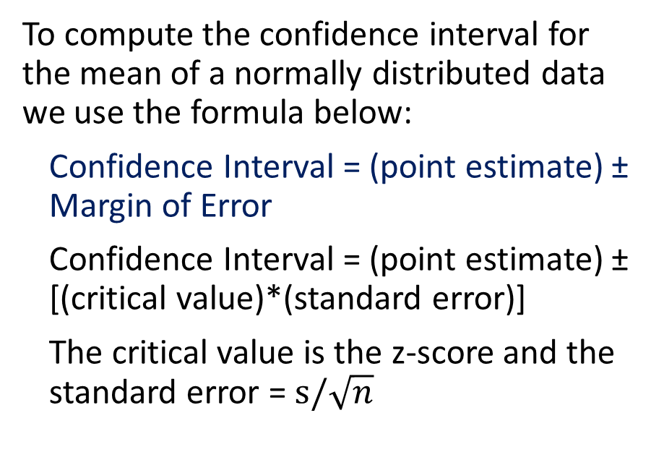
Computing Confidence Intervals
To compute the confidence interval for the mean of a normally distributed data we use the formula below:
Confidence Interval = (point estimate) ± Margin of Error
Confidence Interval = (point estimate) ± [(critical value)*(standard error)]
The critical value is the z-score and the standard error = $s/\sqrt{n}$
https://medium.com/@ashisharora2204/hypothesis-testing-confidence-interval-level-margin-of-error-39aa7c7ddcd2

Slide 8
The Significance Level Alpha (α) and The Confidence Level
To compute the confidence interval, we need to define the Significance Level Alpha (α) or the Confidence Level.
The two terms are related to each other according to the following equation:
Confidence level= 1 – α
Common values for these notations are listed in the table
Alpha - α | 5% | 1%
Confidence level | 95% | 99%
z-Value | 1.96 | 2.58

Slide 9
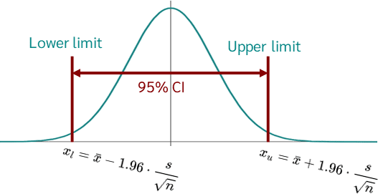
The Significance Level Alpha (α) and The Confidence Level
The confidence level (e.g. 95%) means that if we collected 100 samples and created confidence intervals for each of these samples, we would expect that 95% of these confidence intervals will contain the true population parameter.
It's important to note that this is a theoretical long-term proportion—it's about what we'd expect to happen over many repetitions of the same process, not a guarantee for any individual interval.

Slide 10
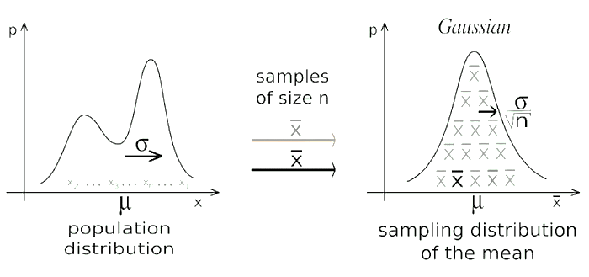
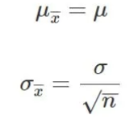

Where did the Standard Error Come From? The Central Limit Theorem
The Central Limit Theorem (CLT) states that samples means created from large number of samples will be approximately normally distribution although the distribution we sample from might not be normal.
When we collect large number of samples and we compute the average for each of these samples, we call the generated means as the Sampling Distribution of the means.
The distribution of samples means becomes more normal when the samples size increases.
According to CLT:
1- The mean of the sampling distribution would be equal to the mean of the original distribution.
2- The variance of the sampling distribution of the sample mean would be equal to the variance of the original distribution divided by n, where n is the size of the samples.
Click here for a CLT simulator.

Slide 11
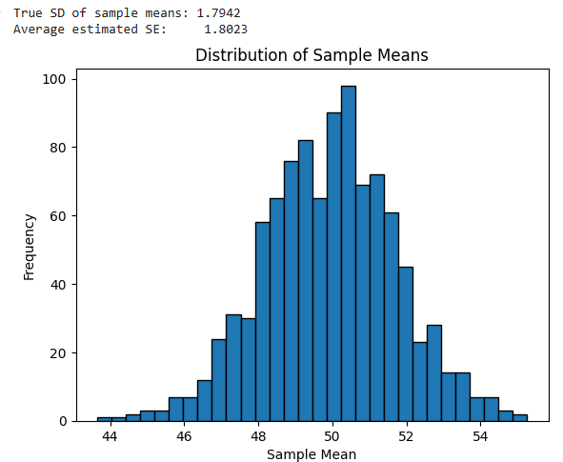
Empirical Proof that Standard Error is an Approximate for the True SD of Sample Means
import numpy as np
import matplotlib.pyplot as plt
# Set population parameters
population = np.random.normal(loc=50, scale=10, size=1000000)
true_sigma = np.std(population)
# Simulation setup
sample_size = 30
num_samples = 1000
sample_means = []
sample_sds = []
for _ in range(num_samples):
sample = np.random.choice(population, sample_size)
sample_means.append(np.mean(sample))
sample_sds.append(np.std(sample, ddof=1))
# Calculate actual SD of sample means
sd_of_sample_means = np.std(sample_means)
# Calculate average standard error estimate
average_se = np.mean([s / np.sqrt(sample_size) for s in sample_sds])
print(f"True SD of sample means: {sd_of_sample_means:.4f}")
print(f"Average estimated SE: {average_se:.4f}")
# Optional: plot histogram
plt.hist(sample_means, bins=30, edgecolor='black')
plt.title('Distribution of Sample Means')
plt.xlabel('Sample Mean')
plt.ylabel('Frequency')
plt.show()

Slide 12
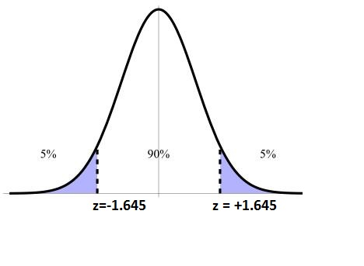
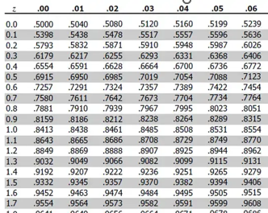
Confidence Intervals Example
Suppose we randomly collected a sample of students with the following information:
Sample size n = 50
Sample mean weight x = 73.16 kg
Population standard deviation s = 8.63
What is the 90% confidence interval for the true population mean weight?
To find the upper bound z-score for the 90% CI, we need to look for area 95% in the z table i.e. 90% + 5% (Look at the Figure)
Therefore, according to the z-table, the upper bound z-score for the 90% Confidence Interval = 1.64 i.e. lower bound is -1.64.
The Margin of Error = 1.64 * (8.63/√50) = ~2
Therefore, the 90% CI = 73.16 ± 2 = [71.16, 75.16]

Slide 13

Confidence Intervals Example
We interpret this 90% confidence interval as follows:
The interval [71.16 kgs to 75.16 kgs] gives us a good estimate of where the mean lies, based on the collective information from our samples.
The 90% means that if we estimate the population parameter and computed the confidence intervals 100 times, we expect that 90% of these intervals will contain our parameter.

Slide 14
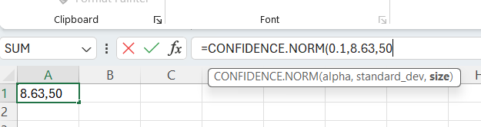
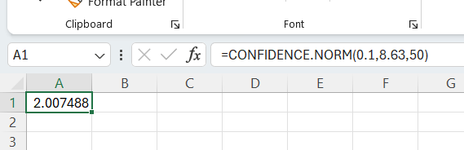
Solving Confidence Intervals using Excel Functions
Suppose we randomly collected a sample of students with the following information:
Sample size n = 50
Sample mean weight x = 73.16 kg
Sample standard deviation s = 8.63
What is the 90% confidence interval for the true population mean weight?
We can compute the confidence interval using Excel CONFIDENCE.NORM function.
This function computes the margin of error.
CONFIDENCE.NORM(.1 , 8.63 , 50) = 2.0074 ~ 2
Therefore, the 90% CI = 73.16 ± 2 = [71.16, 75.16]

Slide 15
Transitioning to T-Distribution
We can use the Z-distribution when the population variance is known or when our data is large enough (n > 30).
However, real-world data often doesn't come with this information.
In practice, the population variance is unknown, and we usually estimate the population variance using the sample variance, which introduces more variability into our statistics.
The T-distribution accommodates this additional uncertainty and is especially useful for small sample sizes.
The T-distribution often serves as a safer alternative because it accounts for the additional uncertainty from estimating the population variance.

Slide 16
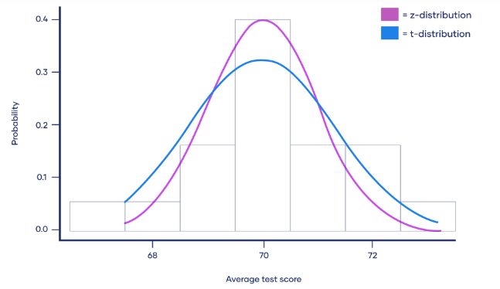
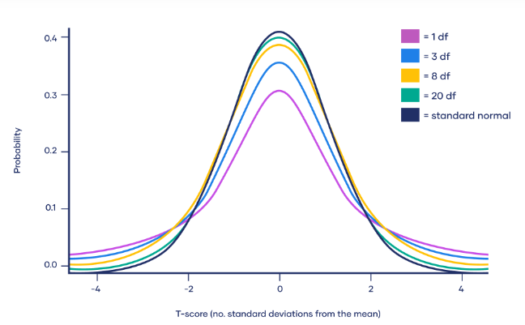
Characteristics of T-Distribution
The T-distribution, like the normal distribution, is bell-shaped and symmetric but has heavier tails.
This means there is more probability in the tails and less in the center compared to a normal distribution.
The exact shape of the T-distribution depends on the degrees of freedom (df), which are related to the sample size.
Degrees of freedom in the context of the T-distribution refer to the number of independent values in a calculation of a statistic that are free to vary.
For a confidence interval, df is equal to the sample size (n) minus 1 (df = n - 1).
As the sample size increases, the T-distribution approaches the normal Z-distribution.
https://www.scribbr.com/statistics/t-distribution/

Slide 17
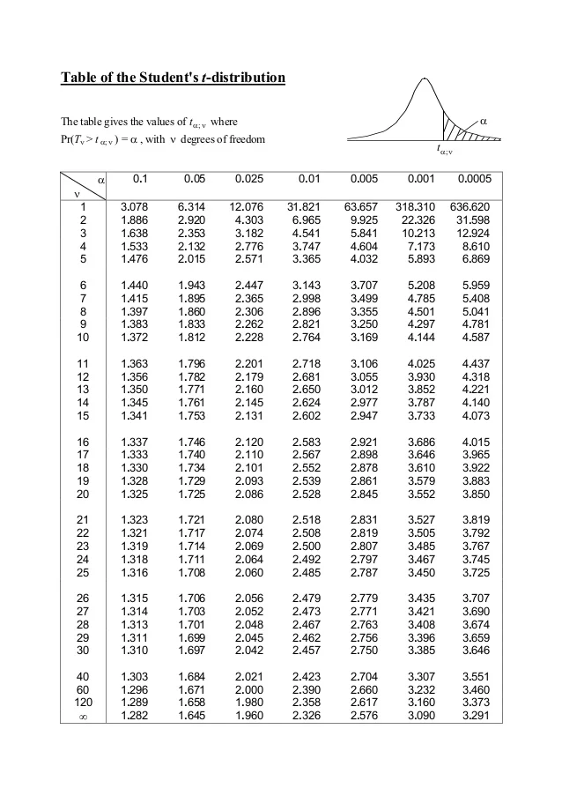
The T Table
The first column, denoted "v," lists the degrees of freedom.
Degrees of freedom typically equal the sample size minus one (n-1) and relate to the number of independent values in a set of observations.
The top row lists different significance levels (α), like the probabilities in z-table.
The intersection of a row and column gives the t-value or t score, which is the cutoff point on the t-distribution.
The table lists the areas (probability) on the right side, of the t-scores (opposite to the z-tables), therefore, to find a t scores for confident intervals we split α by 2 and look out the resulting value in the table.
For example, to find the 90% confidence interval for a sample of 20 observations, we find α which is 1 - .9 = .1
We split α by 2 = .1 / 2 = 0.05 and we lookout that value in the table = 1.729

Slide 18
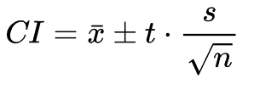
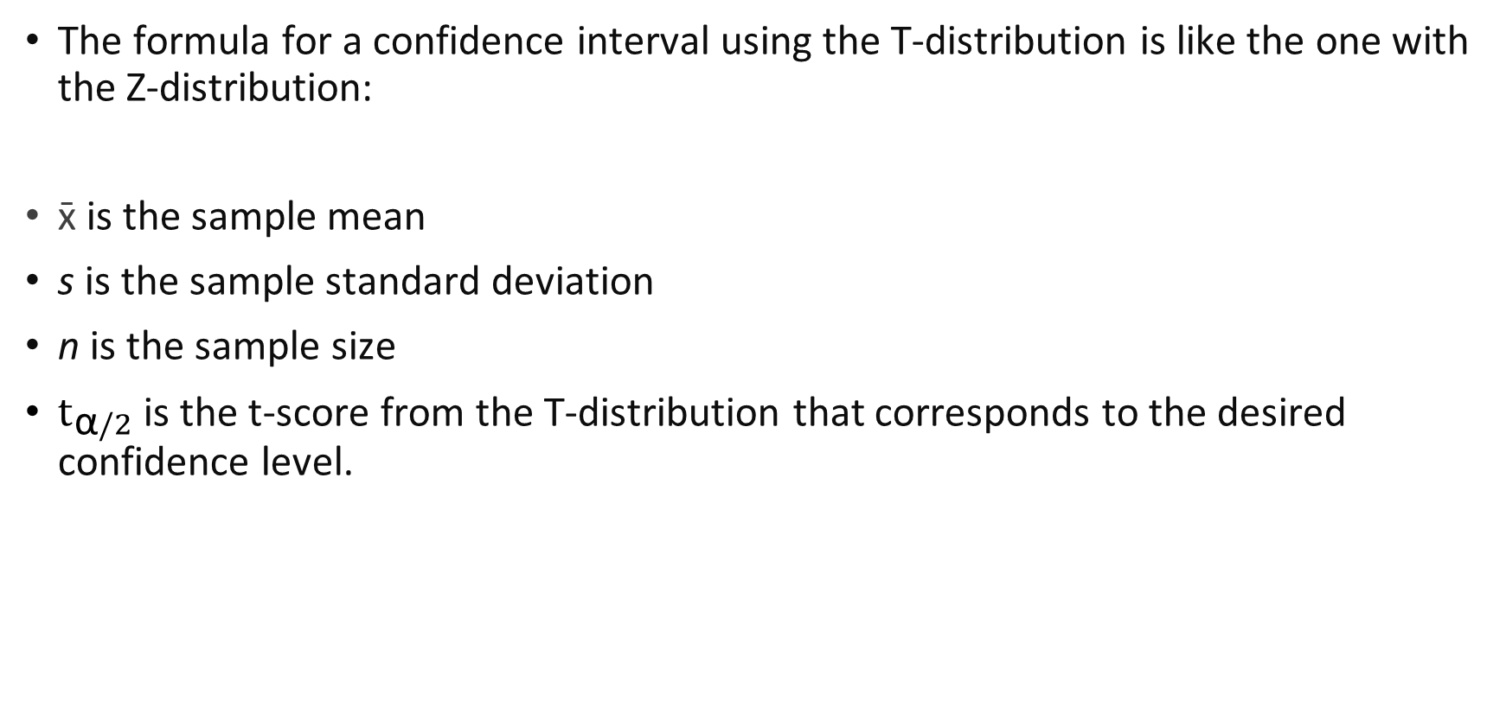
Confidence Intervals Using T-Distribution
The formula for a confidence interval using the T-distribution is like the one with the Z-distribution:
x̄ is the sample mean
s is the sample standard deviation
n is the sample size
$t_{\text{α}/2}$is the t-score from the T-distribution that corresponds to the desired confidence level.

Slide 19
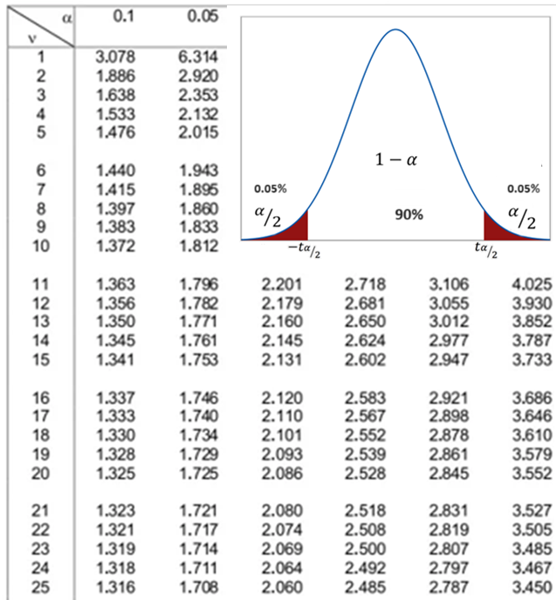
Interval Estimates - Confidence Intervals
Suppose we randomly collected a sample of students with the following information:
Sample size n = 20
Sample mean weight x = 72.94 kg
Samples standard deviation s = 8.3946
What is the 90% confidence interval for the true population mean weight?
Confidence Interval 90% → α = 1 - 0.9 = 0.1 → α/2 = 0.05
According to the t-table, the t-score for the 0.05 with df 20 – 1 = 19 → t score = 1.729
The Margin of Error = 1.729 * (8.3946/√20) = 3.25
Therefore, the 90% CI = 72.94 ± 3.25 = [69.69, 76.19]
What is the difference between the 90% Confidence Interval of the Z-Distribution and the 90% Confidence Interval of the T-Distribution?

Slide 20
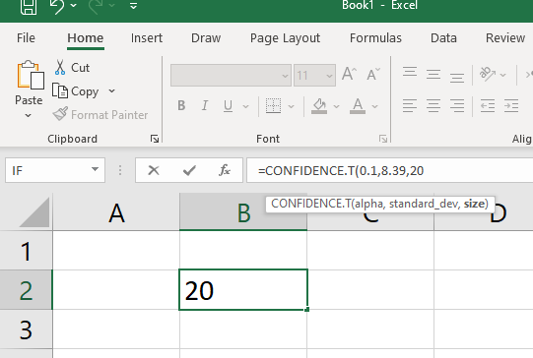
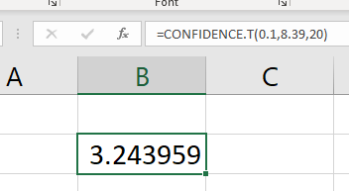
Solving Confidence Intervals using Excel Functions
Suppose we randomly collected a sample of students with the following information:
Sample size n = 20
Sample mean weight x = 72.94 kg
Samples standard deviation s = 8.3946
What is the 90% confidence interval for the true population mean weight?
We can compute the confidence interval using Excel CONFIDENCE.T function.
This function computes the margin of error.
CONFIDENCE.T(.1 , 8. 39 , 20) = 3.24 ~ 2
Therefore, the 90% CI = 72.94 ± 3.24 = [69.69, 76.19]

